Slide 1
Sometimes
at School I Get Upset

Slide 2
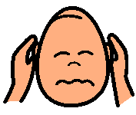
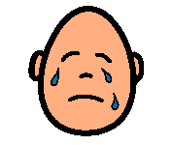
Sometimes when I’m upset, I talk too loudly.
Sometimes when I’m upset, I cry.

Slide 3
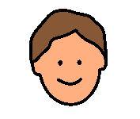
When I’m upset I need to calm down.

Slide 4
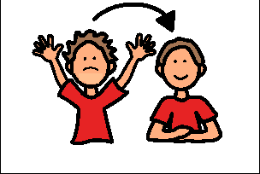
Here are some things I can try to calm down.

Slide 5
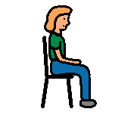
Sit in my chair and rub my legs

Slide 6
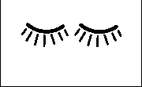
Close my eyes.

Slide 7
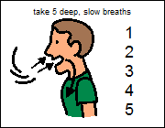
Take 5 deep slow breaths.

Slide 8
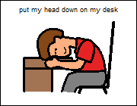
Put my head down on my desk.

Slide 9
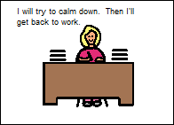
I will try to calm down. Then l’ll get back to work.

Slide 10
