Slide 1
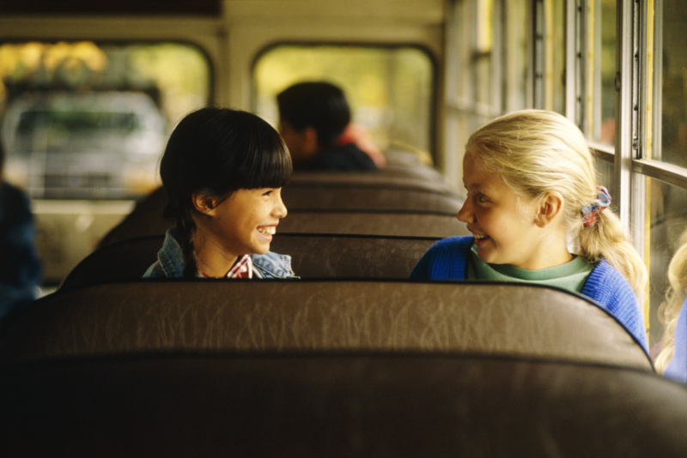

Are You Really My Friend?

Slide 2
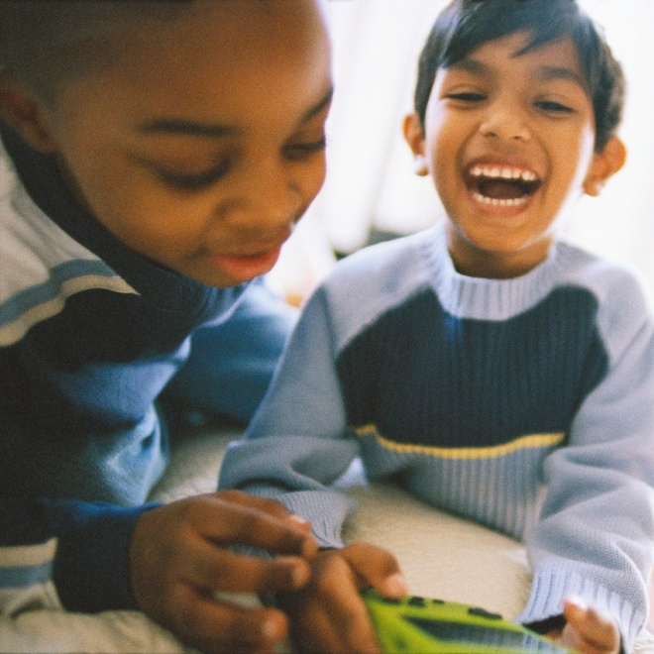
What is a friend?
A friend is someone who you like to be with.

Slide 3
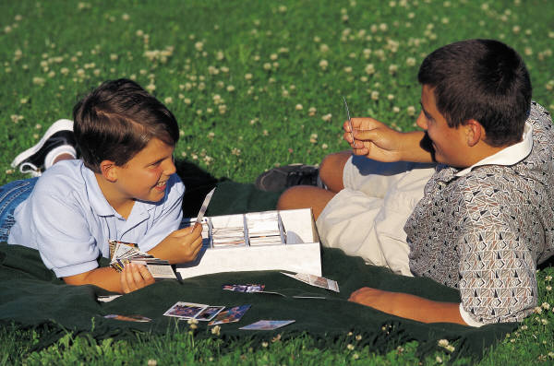
What is a friend?
A friend plays with you and laughs with you.

Slide 4
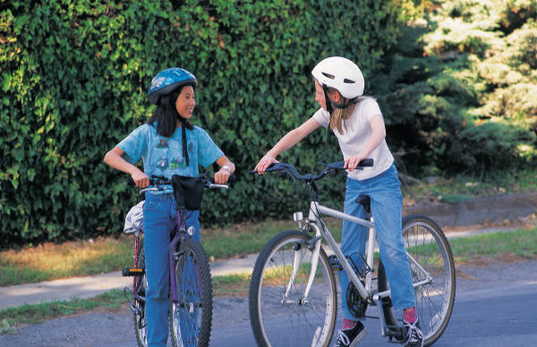
What is a friend?
A friend is someone who will talk with you and share with you.

Slide 5
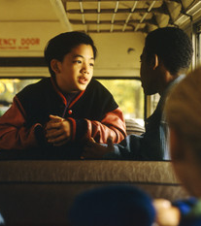
Do you think these kids are friends?
They are talking on the school bus. They are being friendly.
YES! These kids ARE friends!

Slide 6
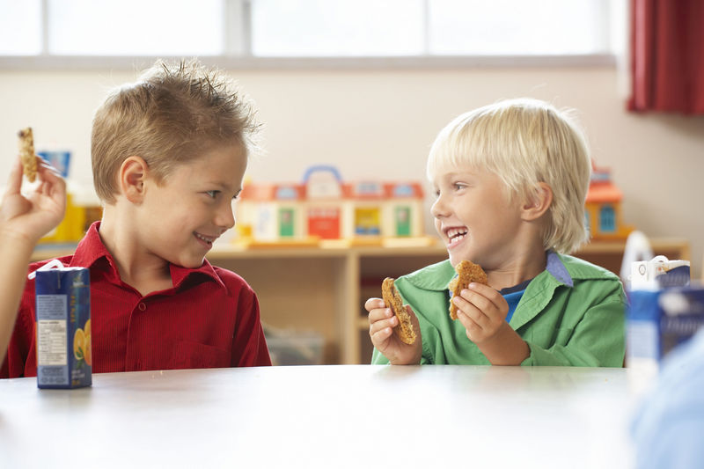
Do you think these kids are friends?
They are having a
snack together. They are
looking at each other and
laughing.
YES! These two boys ARE friends!

Slide 7

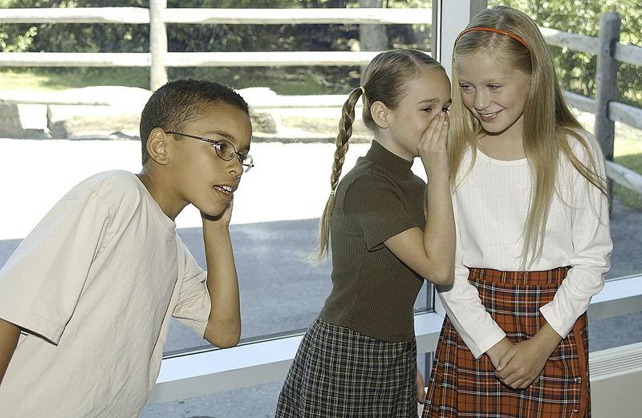
Now..look at this picture
Are the girls being
friendly to the boy?

Slide 8
The girls are laughing, but they are not including the boy. They are telling secrets and laughing AT the boy.
They are NOT being friendly to the boy. They are teasing him.

Slide 9

How do you know when someone is teasing?
When someone is teasing, they tell secrets about you and laugh with their friends.

Slide 10
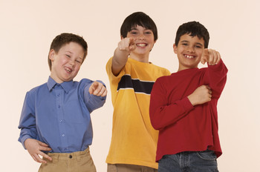
When someone is teasing,
they try to get you to say or do something that you don’t want to do.
If you do it, they might laugh at you.
They are NOT being friends!

Slide 11

What should you do if a kid…
tries to get you to say or do something that you DON’T want to do?
You can tell them…

Slide 12

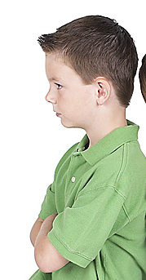
Cut it out!
Stop bothering me!
AND THEN………….

Slide 13
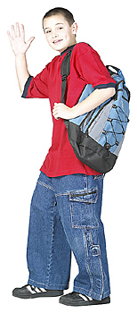
WALK AWAY….
I’m walking away from them– I think they are trying to make me do something I don’t want to do
I don’t think these guys are my friends!

Slide 14
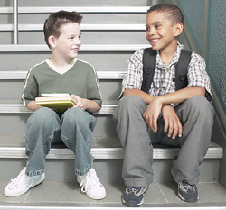
It is best to talk to people who are being friendly!
This guy is definitely my friend!
He laughs WITH me, he talks WITH me.

